Slide 1

Our Project

Slide 2
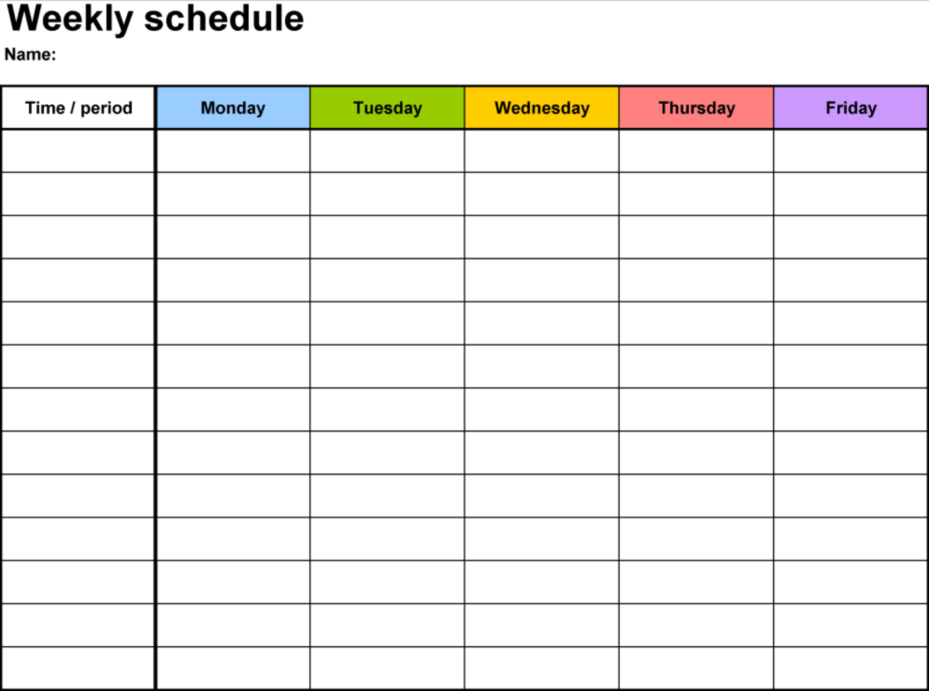
GROUP SCHEDULE

Slide 3

LEARNING
What is it that you expect to learn from this project?
What is something you want to learn from this project that we have not included?
What are you most excited about?
Are there any software purchases that we should consider?

Slide 4
PROJECT PLANNING
TRELLO LAYOUT
GAME ENGINE
GAME GENRE
Provide information here
Provide information here
Provide information here

Slide 5
What is Trello?

Slide 6
What is GitHub?

Slide 7
How will we begin?
Start off small. Do something that does not require too much time or effort and keep it simple.
Suggestions?

